Slide 1
物聯網實務 HW12
電機碩一 11278008 林佳慧
日期:2023/12/06

Slide 2
Exercise 12-1
training a model in Python

Slide 3
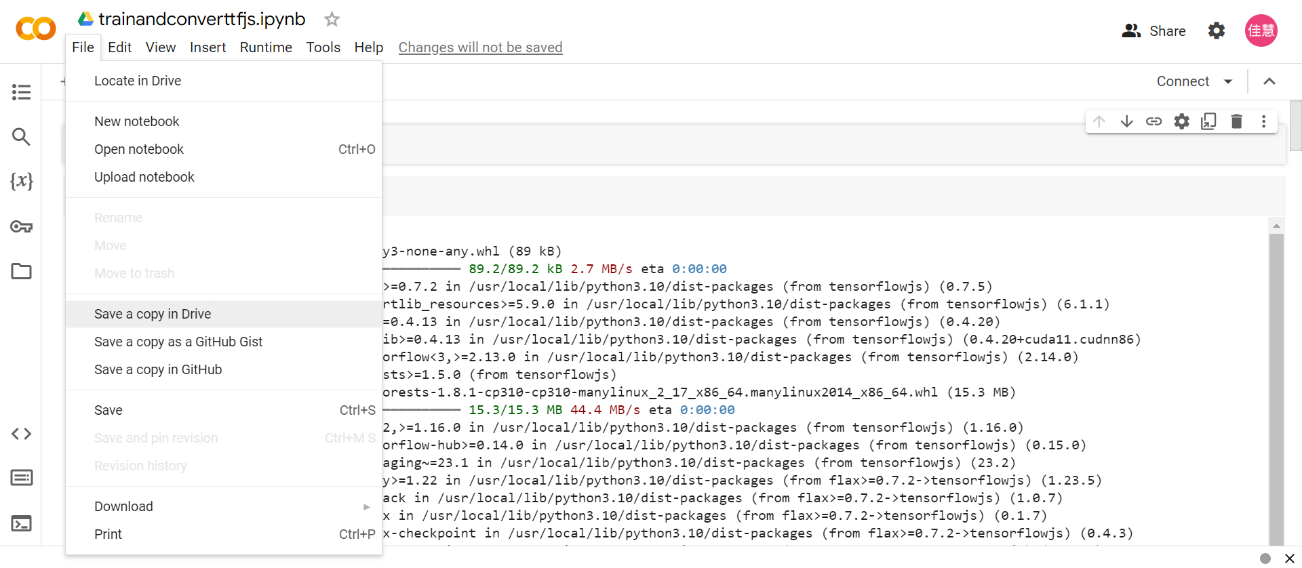
Code in Colab

Slide 4
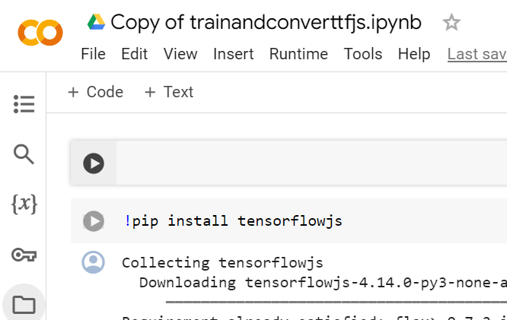
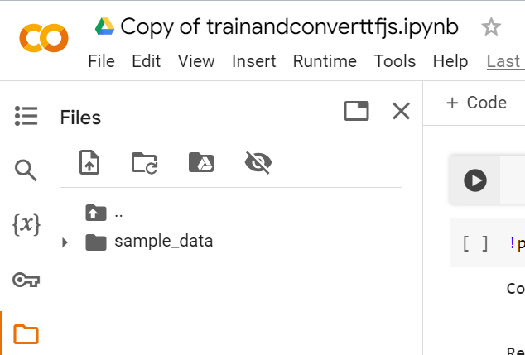
Copy of trainandconverttfjs.ipynb

Slide 5
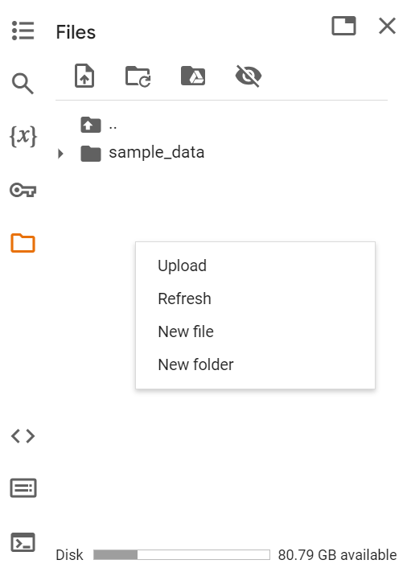
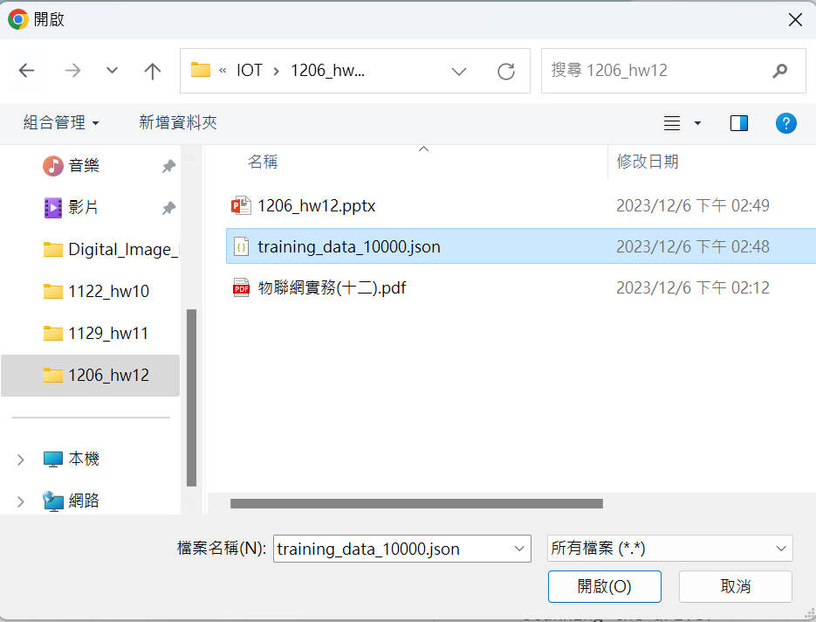
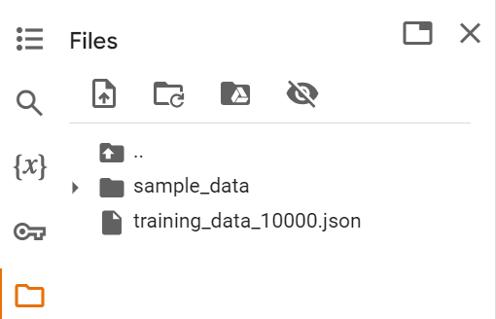
Upload
training_data_10000.json
Colab

Slide 6
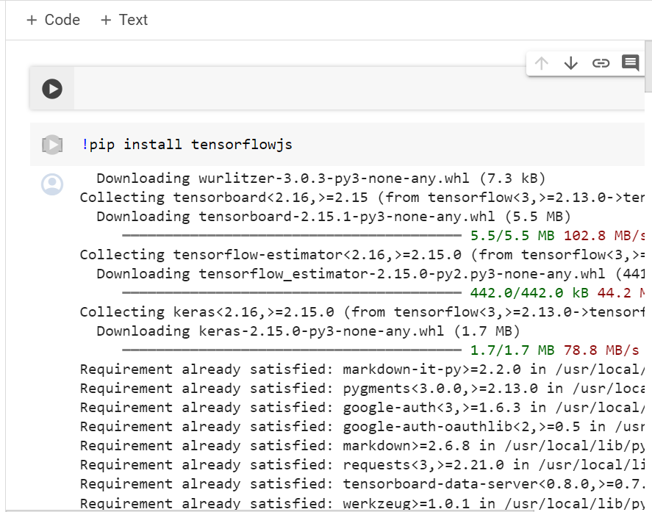
!pip install tensorflowjs

Slide 7
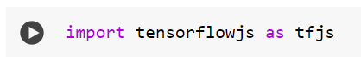
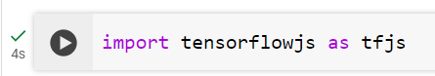
import tensorflowjs as tfjs

Slide 8
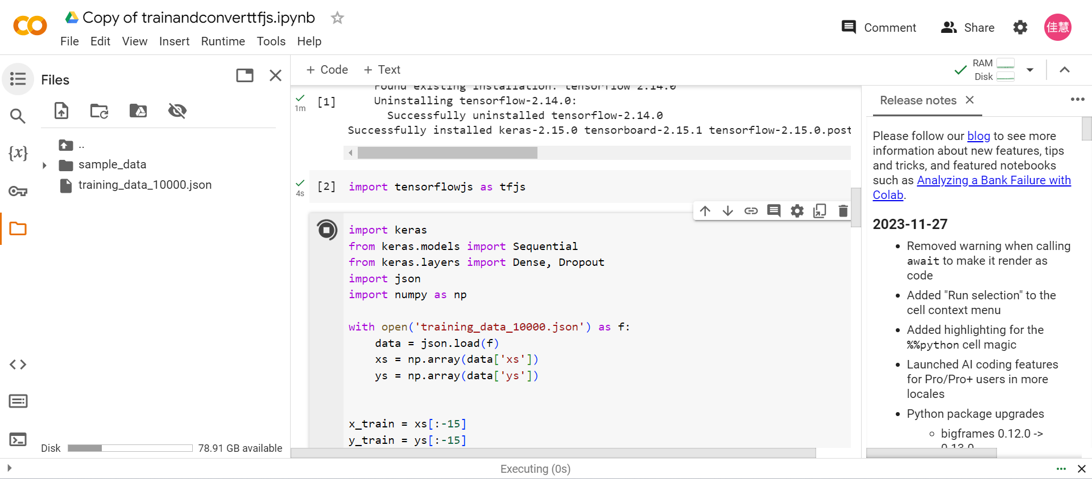
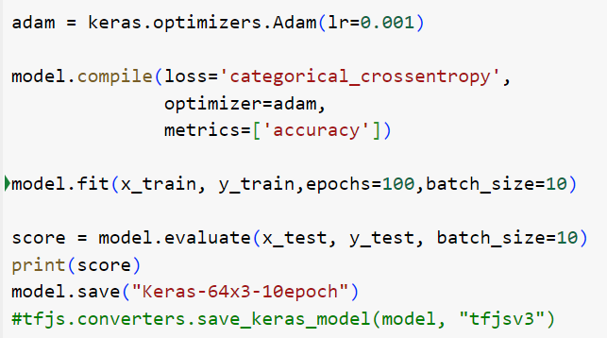
train

Slide 9
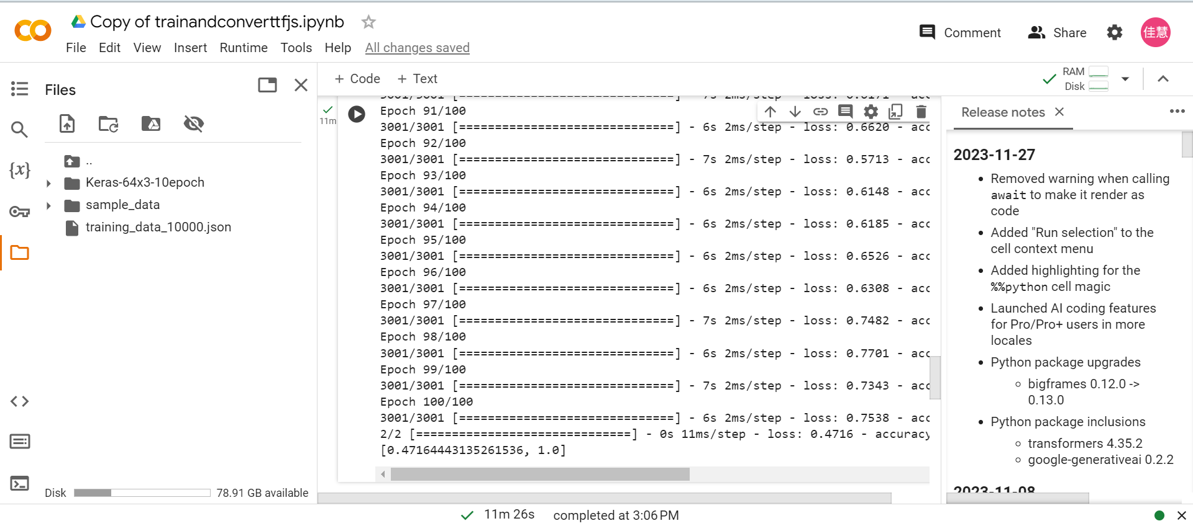
generate Keras-64x310epoch

Slide 10
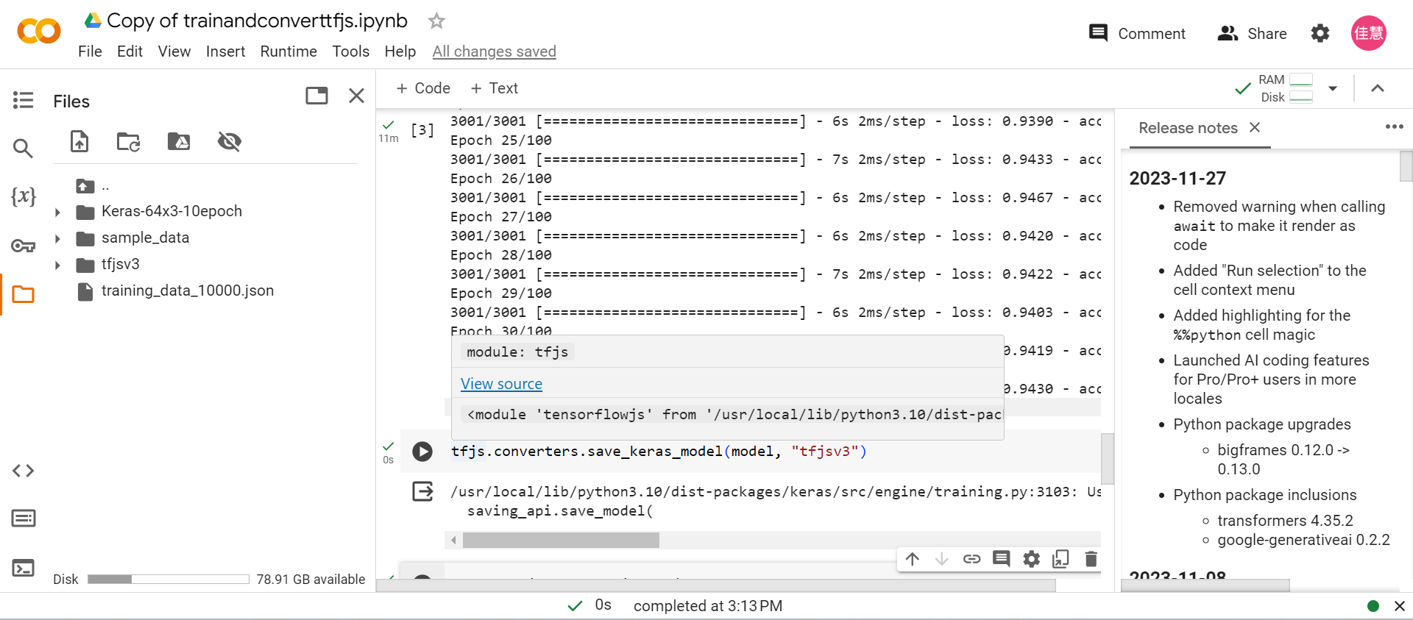
tfjs.converters.save_keras_model(model, "tfjsv3")

Slide 11
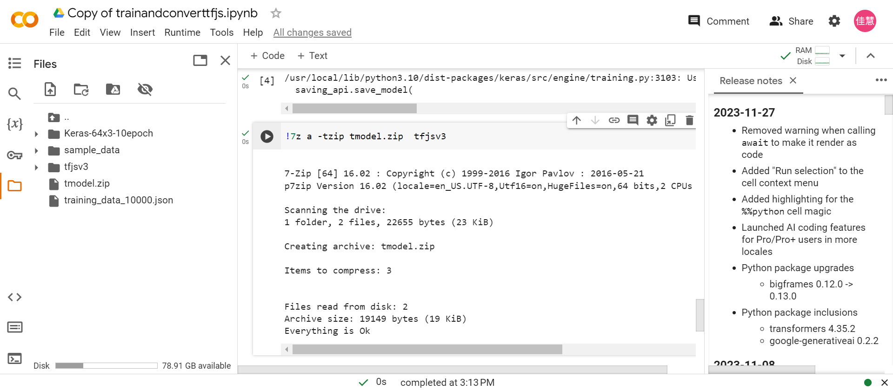
!7z a -tzip tmodel.zip tfjsv3

Slide 12
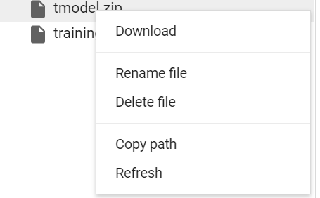
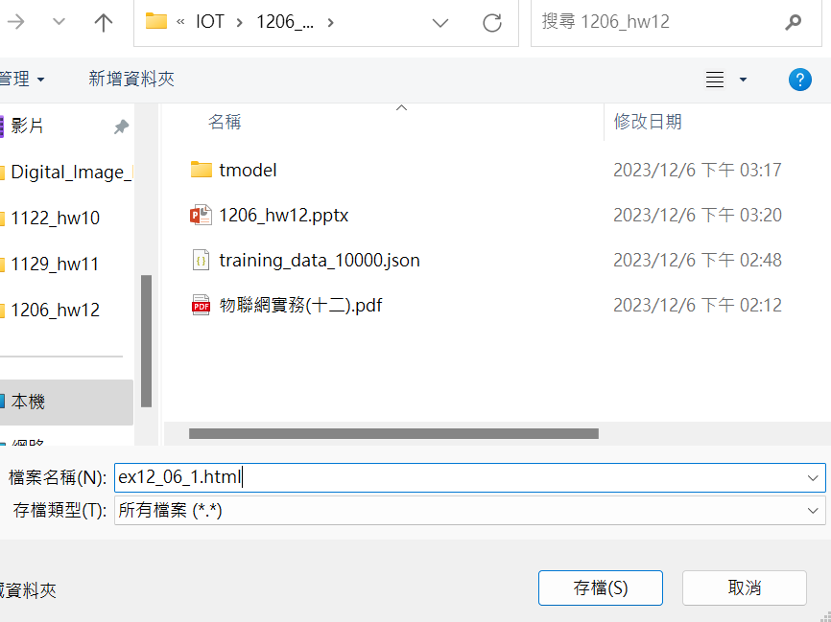
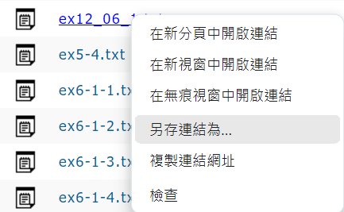
Download
Save as html file
Download ex12_06_1.html

Slide 13
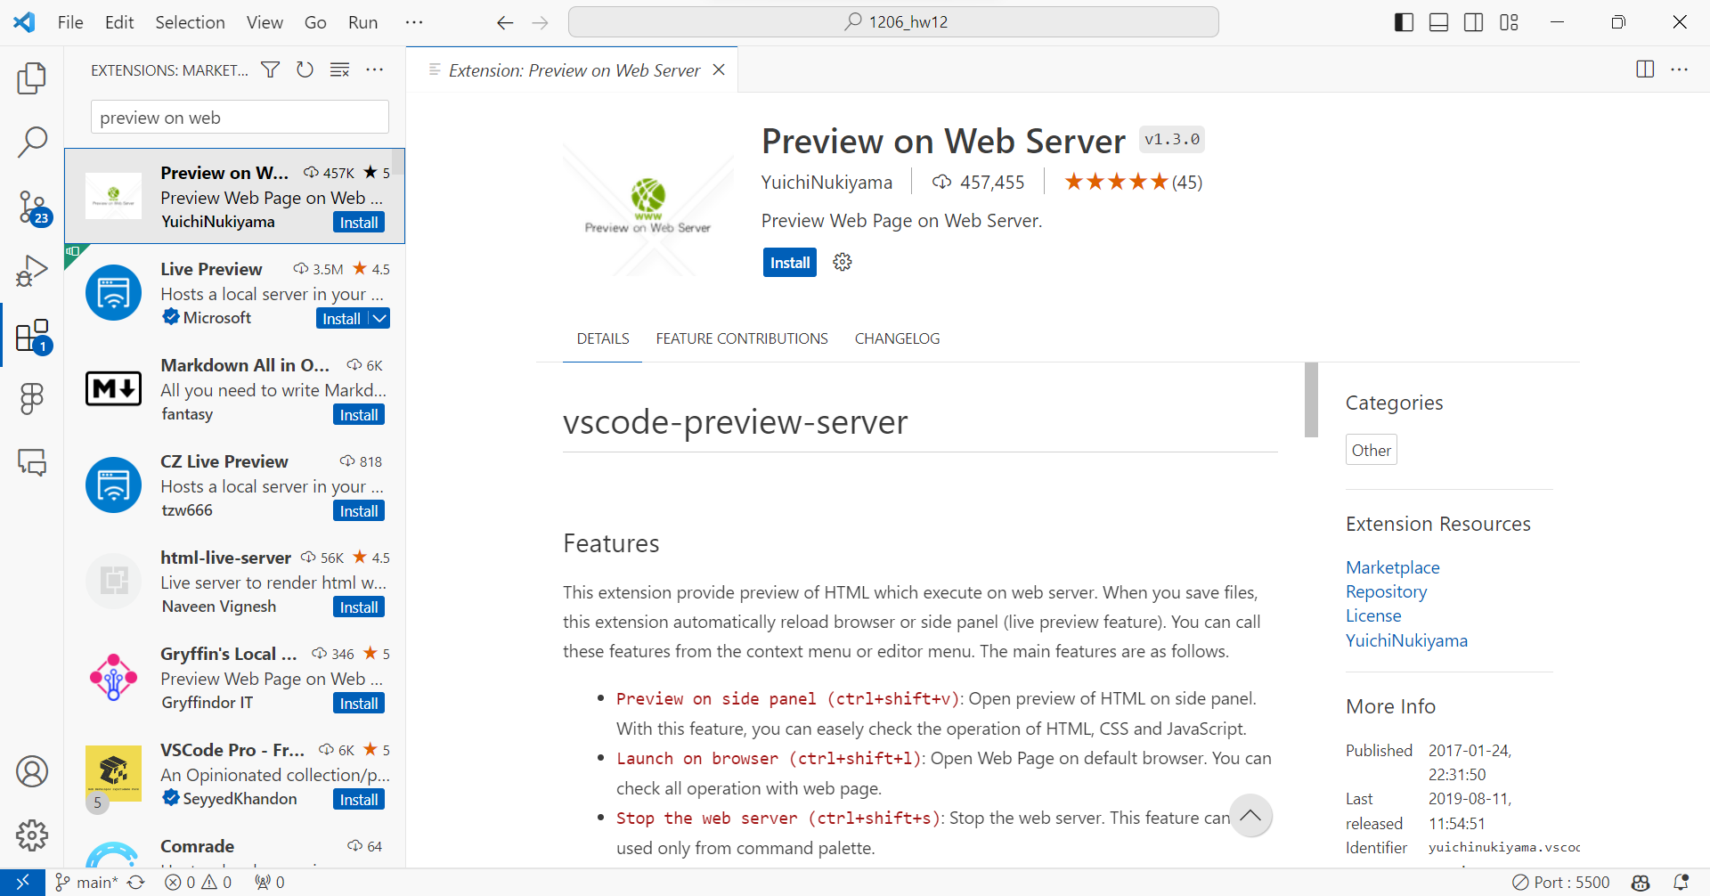

Slide 14
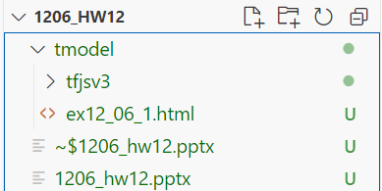
須將這兩個檔案放在同一個資料夾

Slide 15
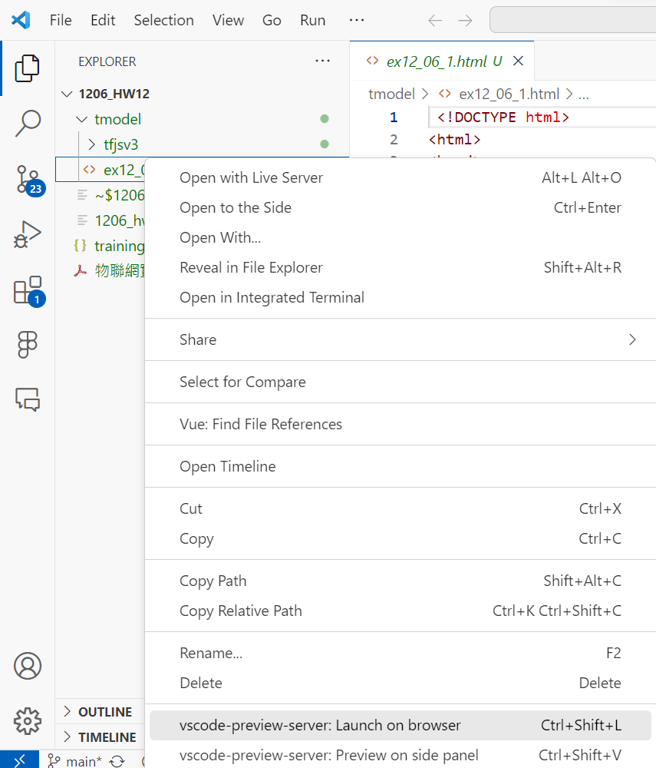
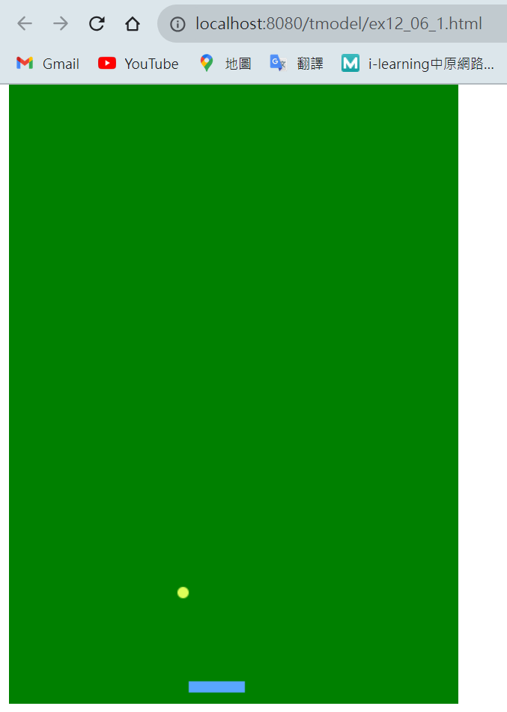
Right click
localhost:8080/ex12_06_1.html

Slide 16
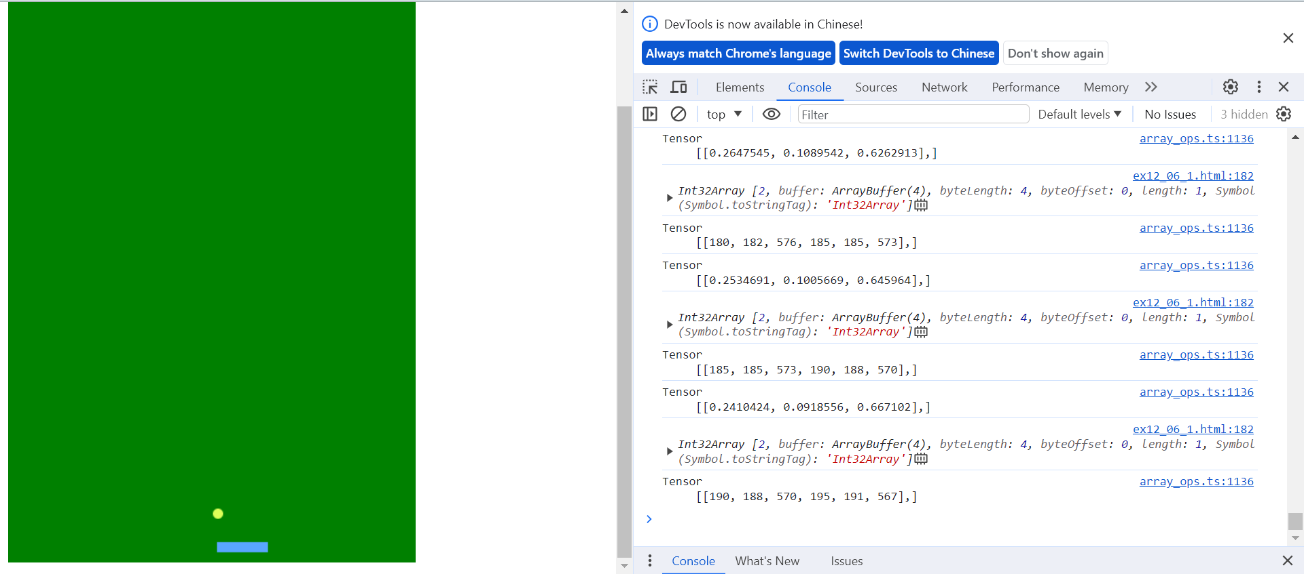
Ctrl+shift+I/ F12

Slide 17
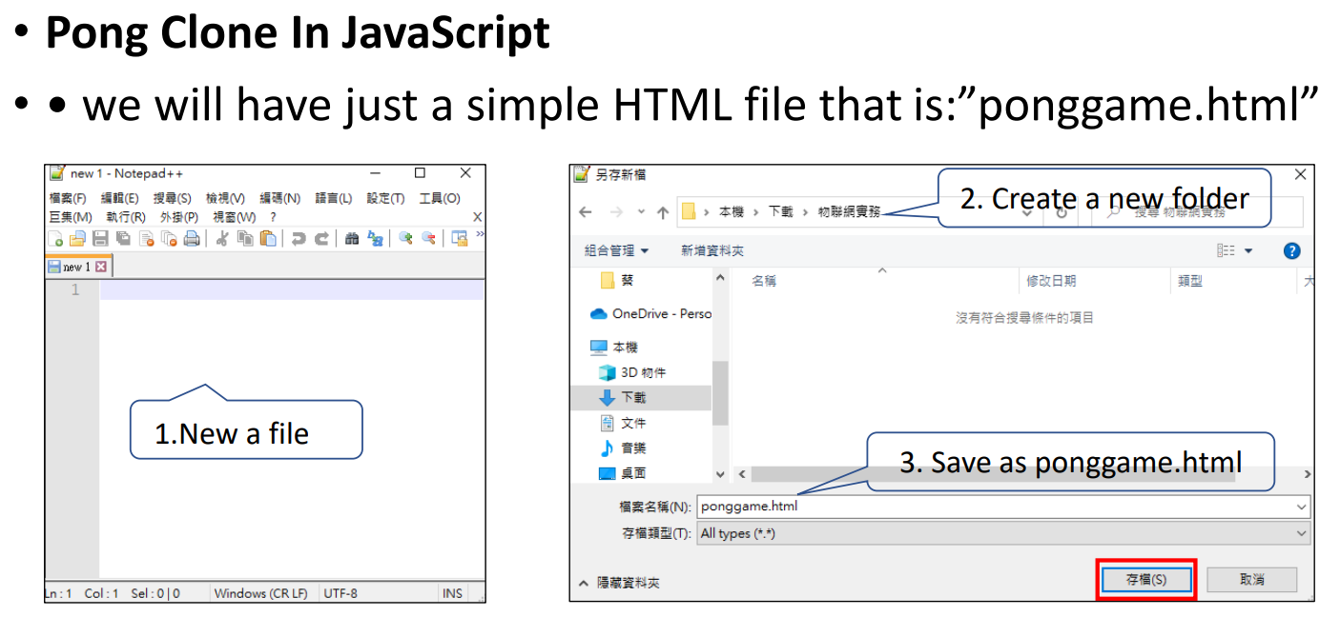
Exercise 12-2

Slide 18
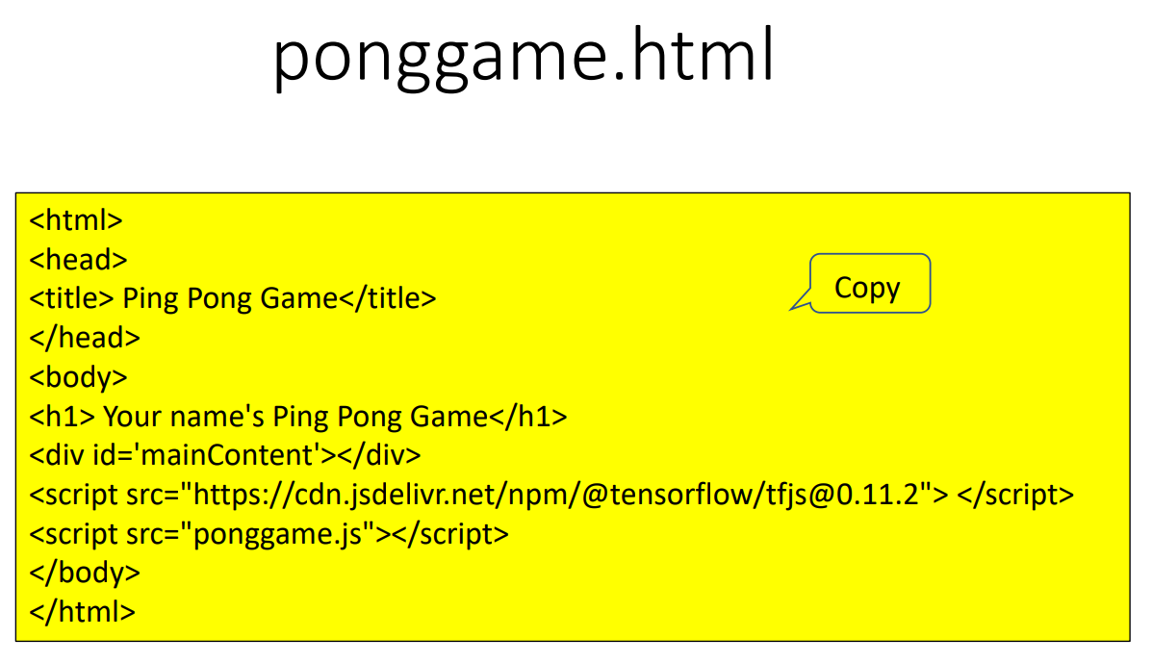

Slide 19
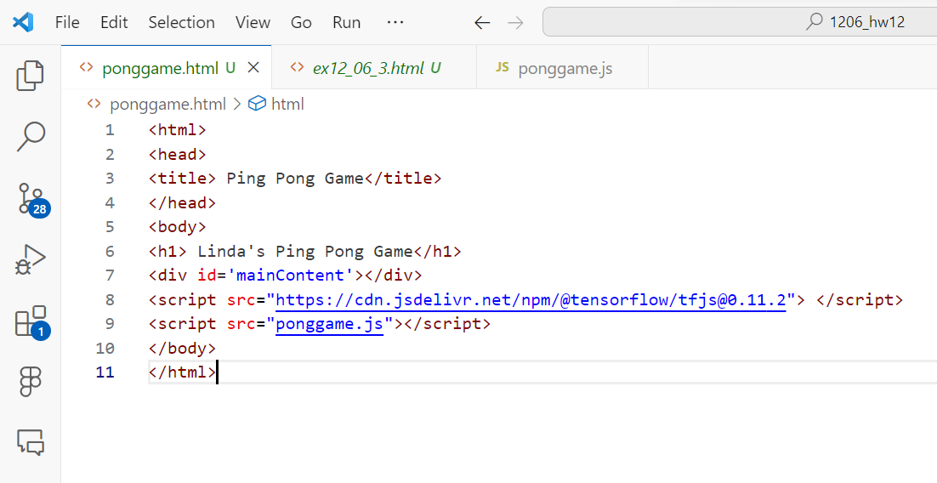
Paste & Save

Slide 20
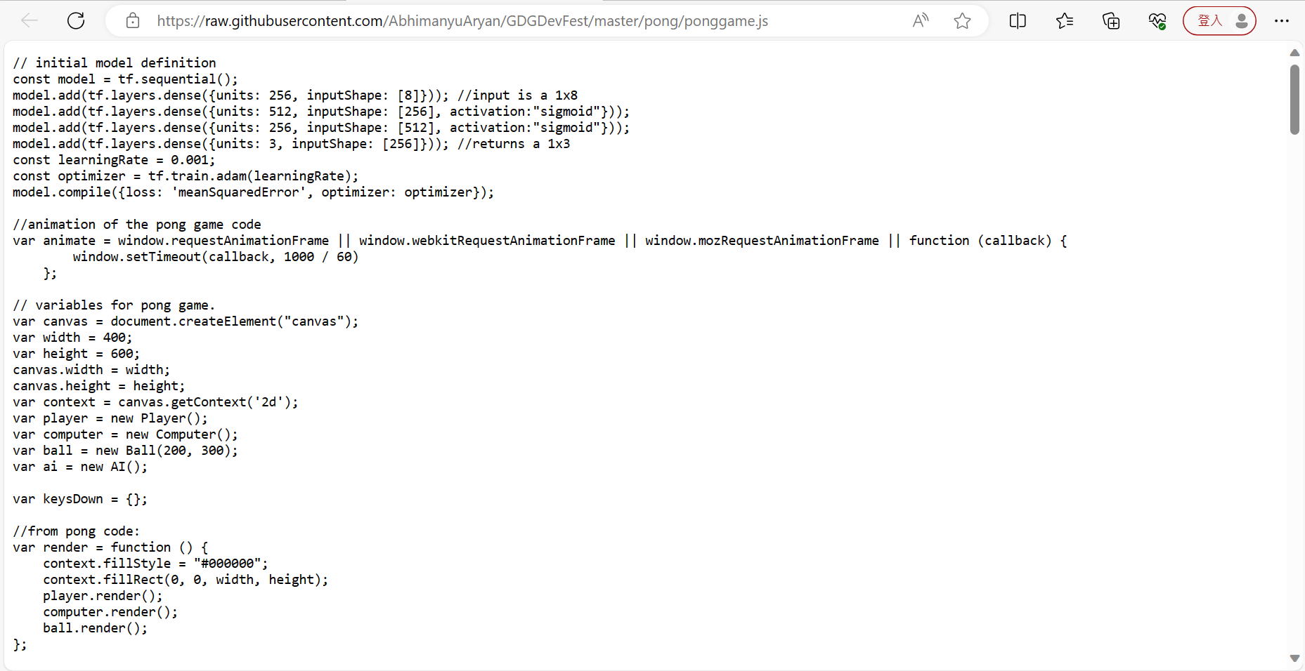
raw.githubusercontent.com/AbhimanyuAryan/GDGDevFest/master/pong/ponggame.js
Copy all

Slide 21
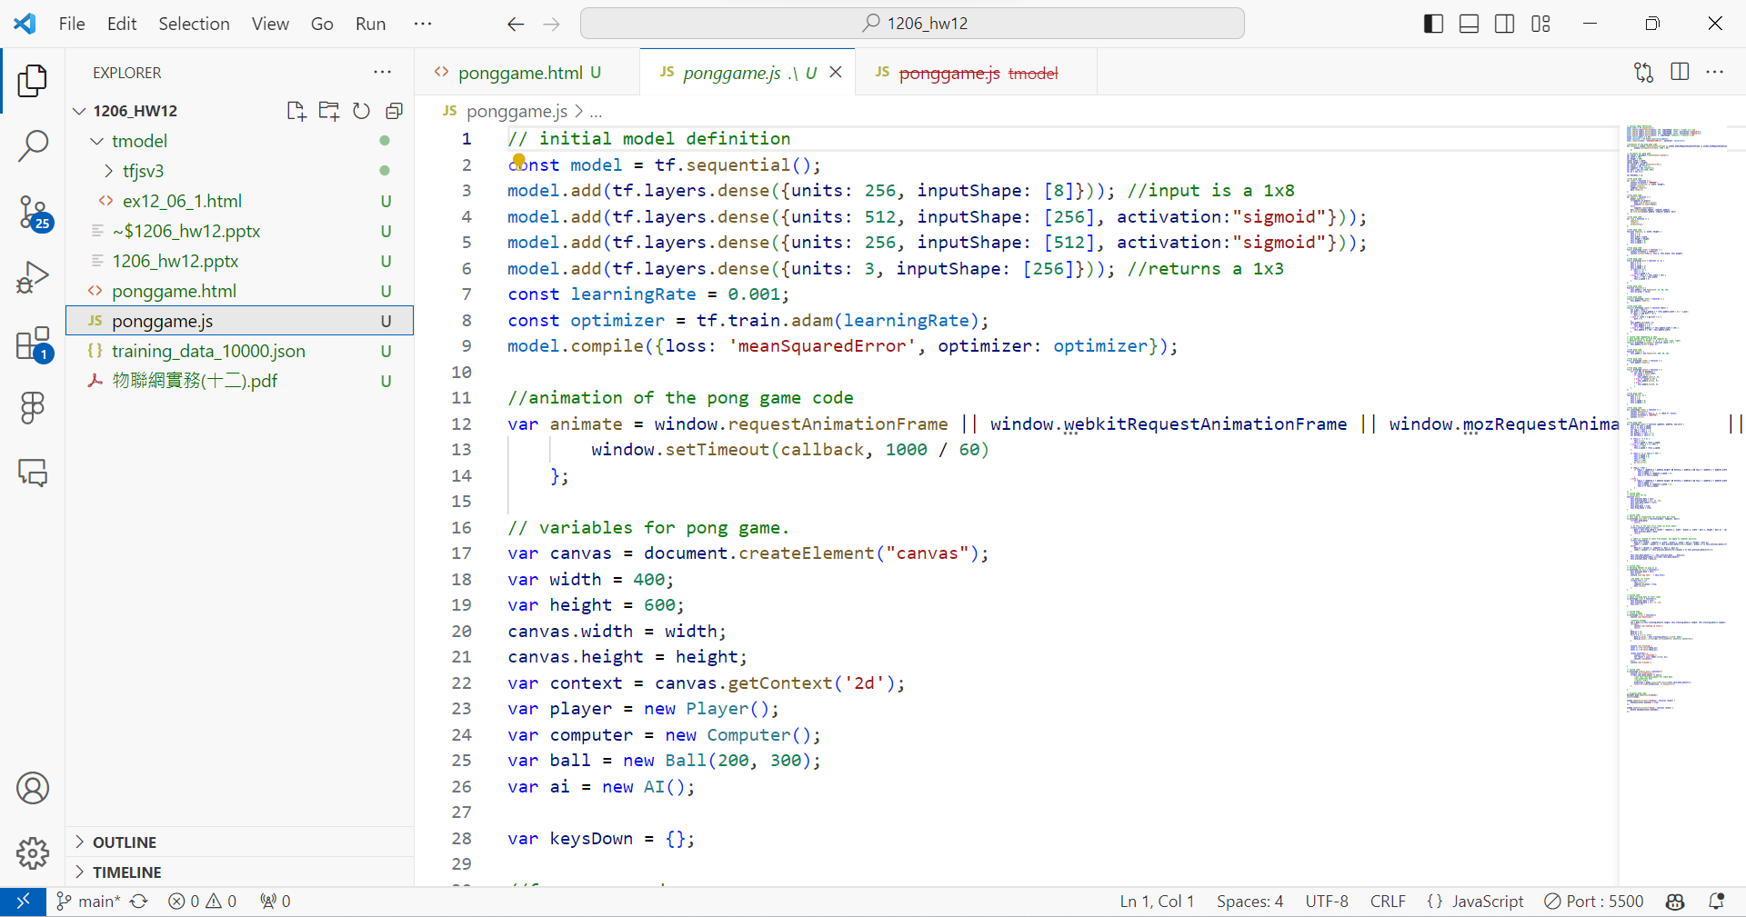
Save as ponggame.js
Paste

Slide 22
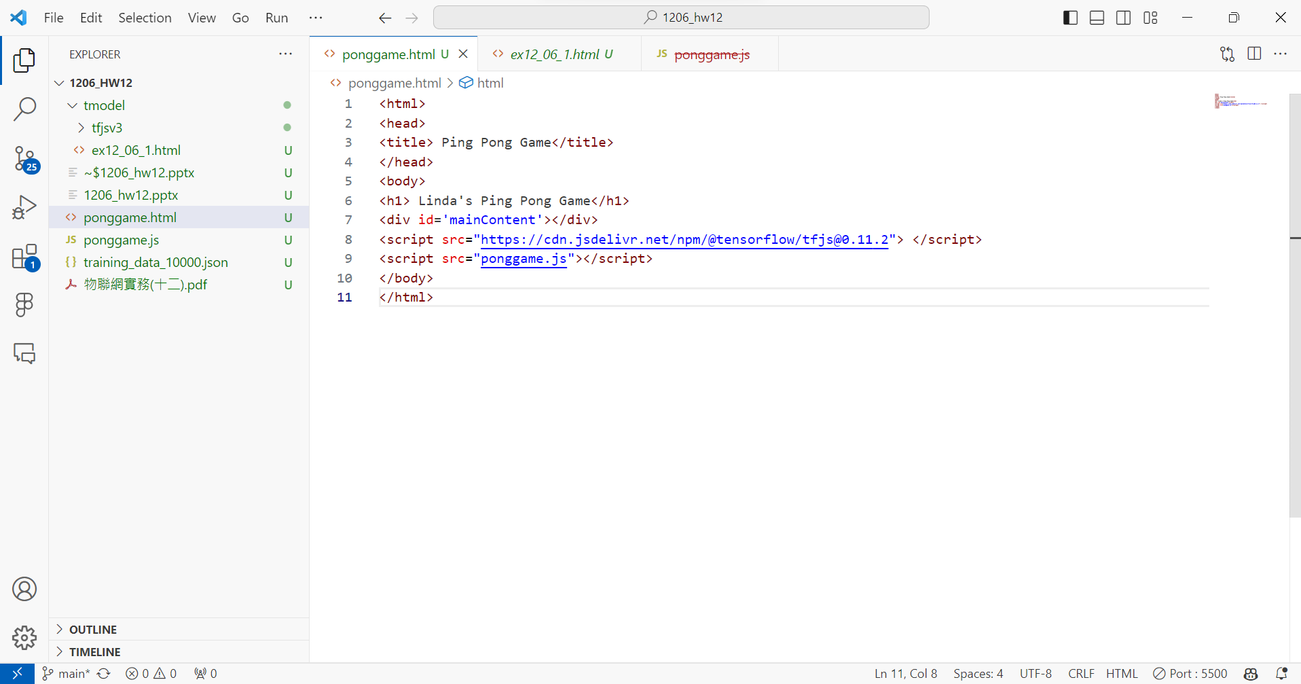
click

Slide 23
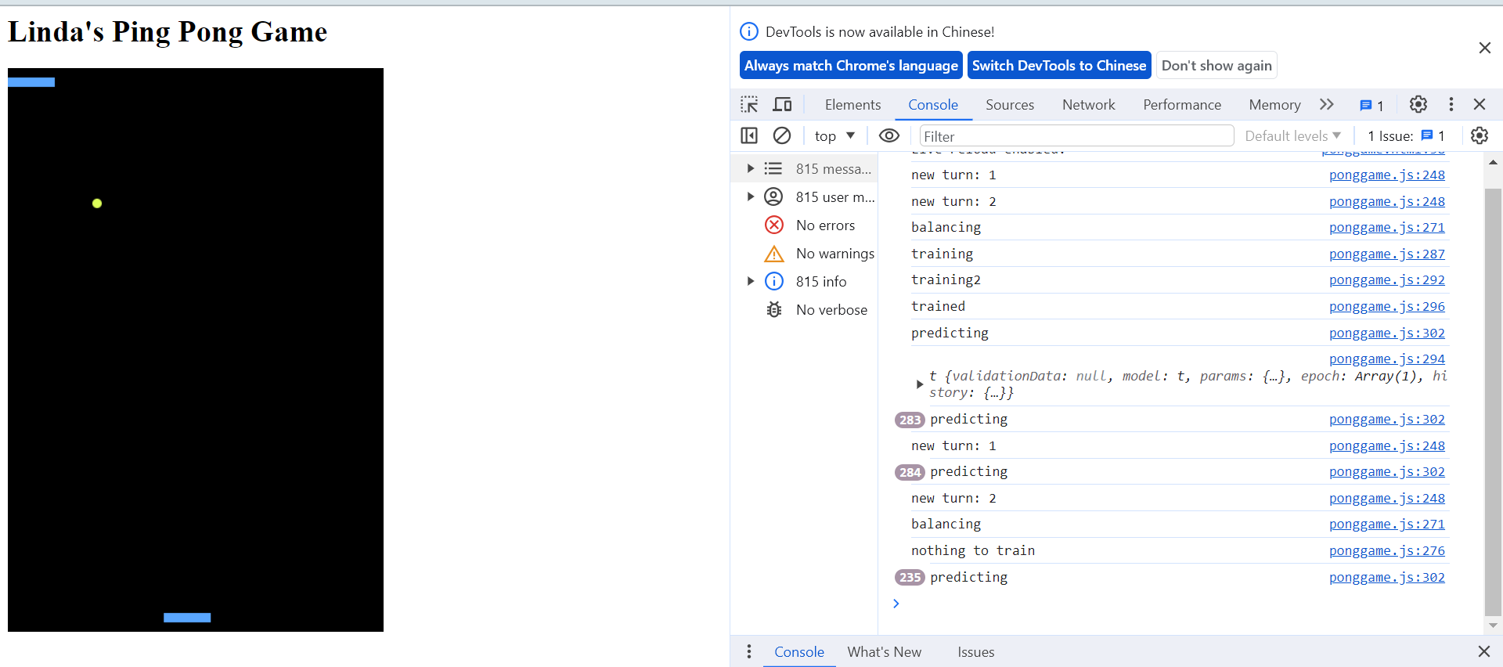
ponggame.html
You can play with AI

Slide 24
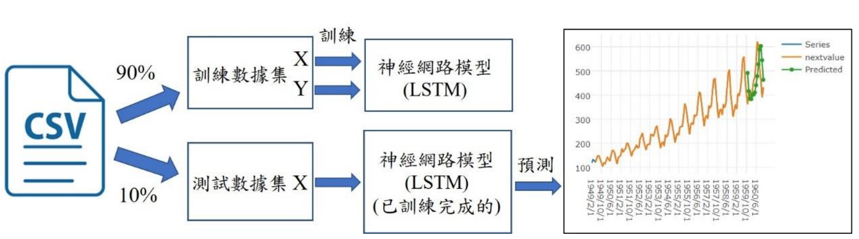
Exercise 12-3
使用csv檔案與LSTM網路進行時間序列預測的實驗架構圖

Slide 25
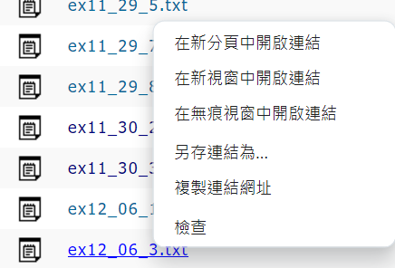
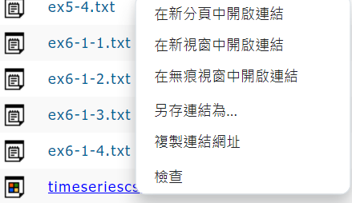
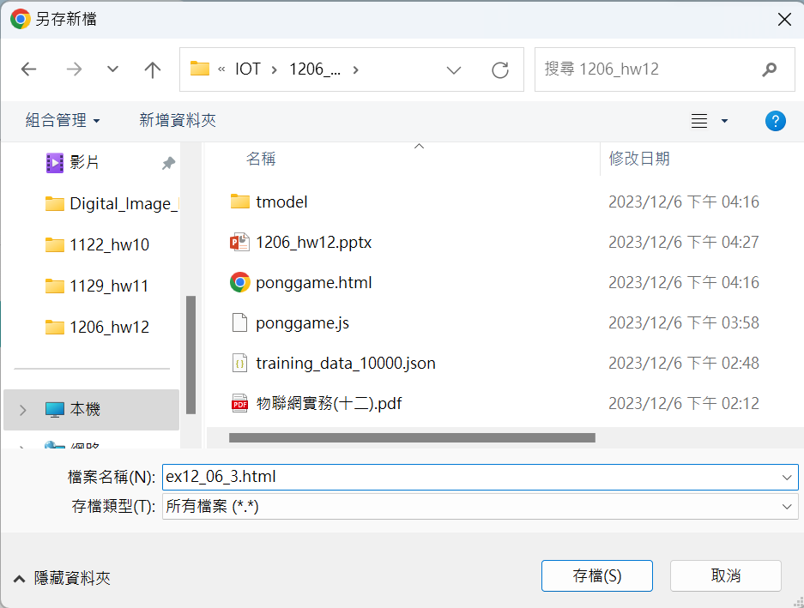
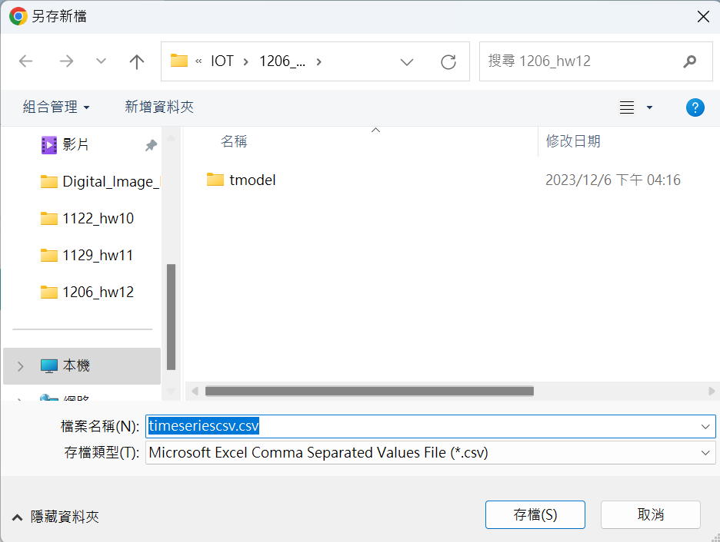
Download ex12_06_3.txt
Download timeseriescsv.csv
Right click
Right click
Save as ex12_06_3.html
Save

Slide 26
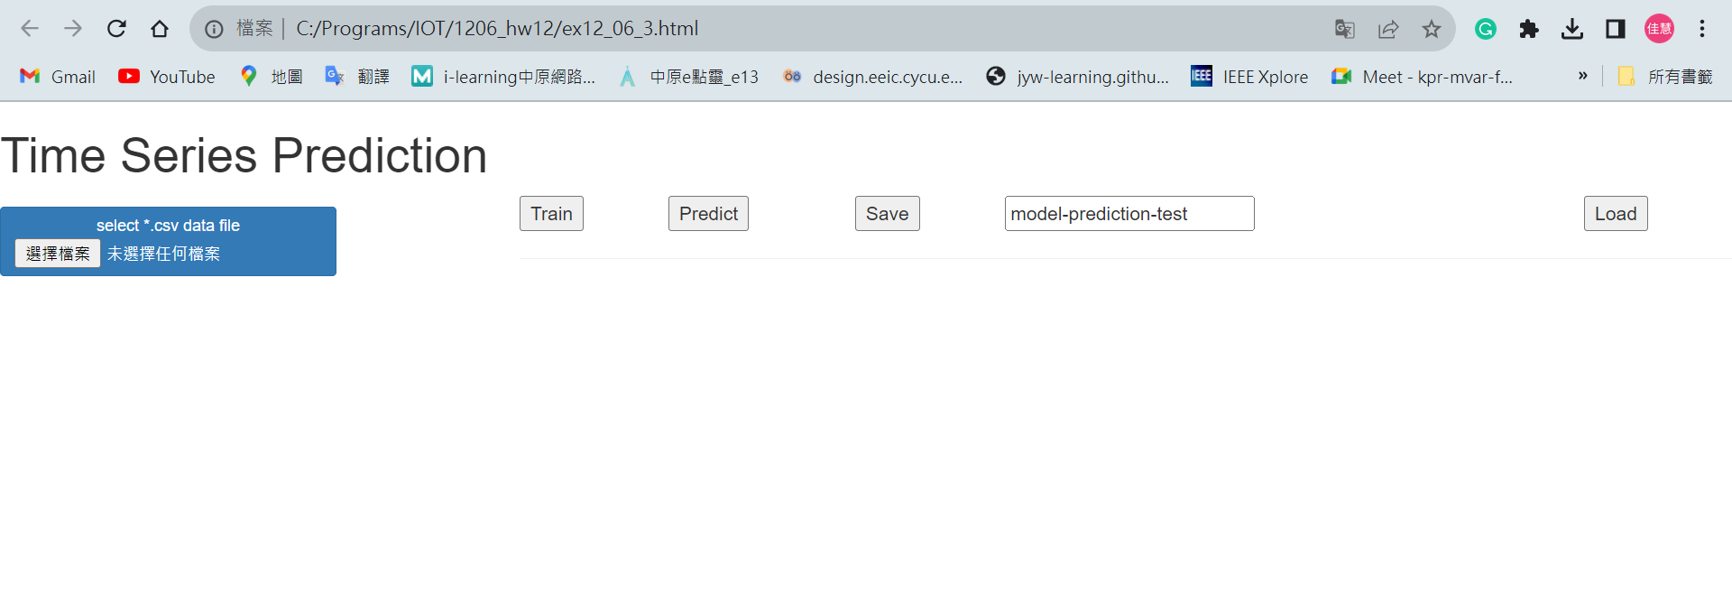
2. Train
3. Predict
1. 選出”timeseriescsv.csv”

Slide 27
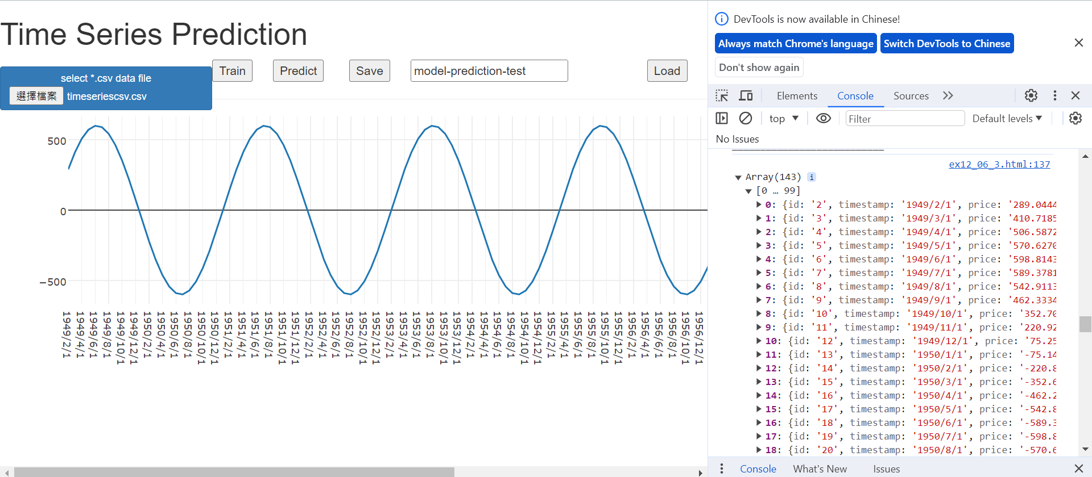
1. Ctrl+shift+I / F12

Slide 28
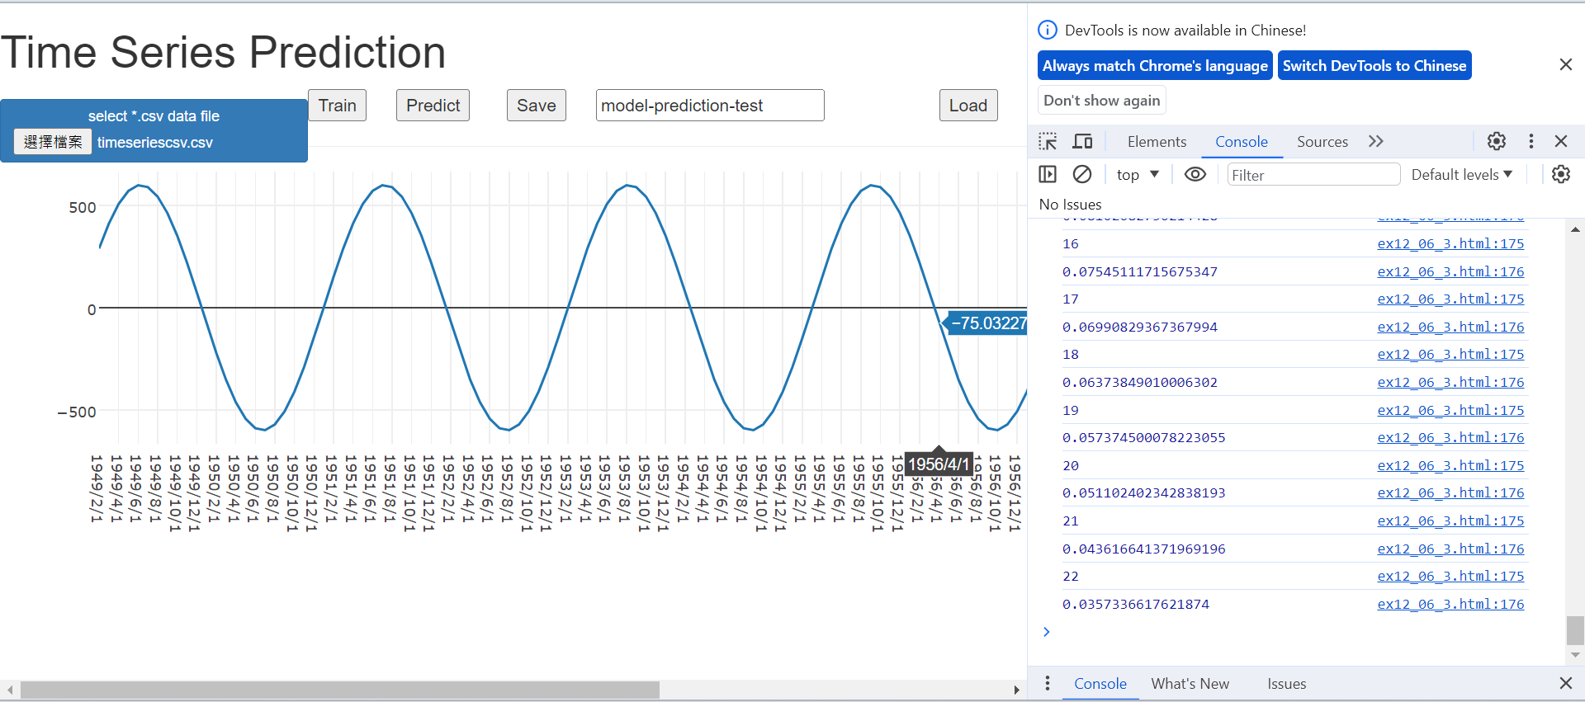
Train
Train

Slide 29
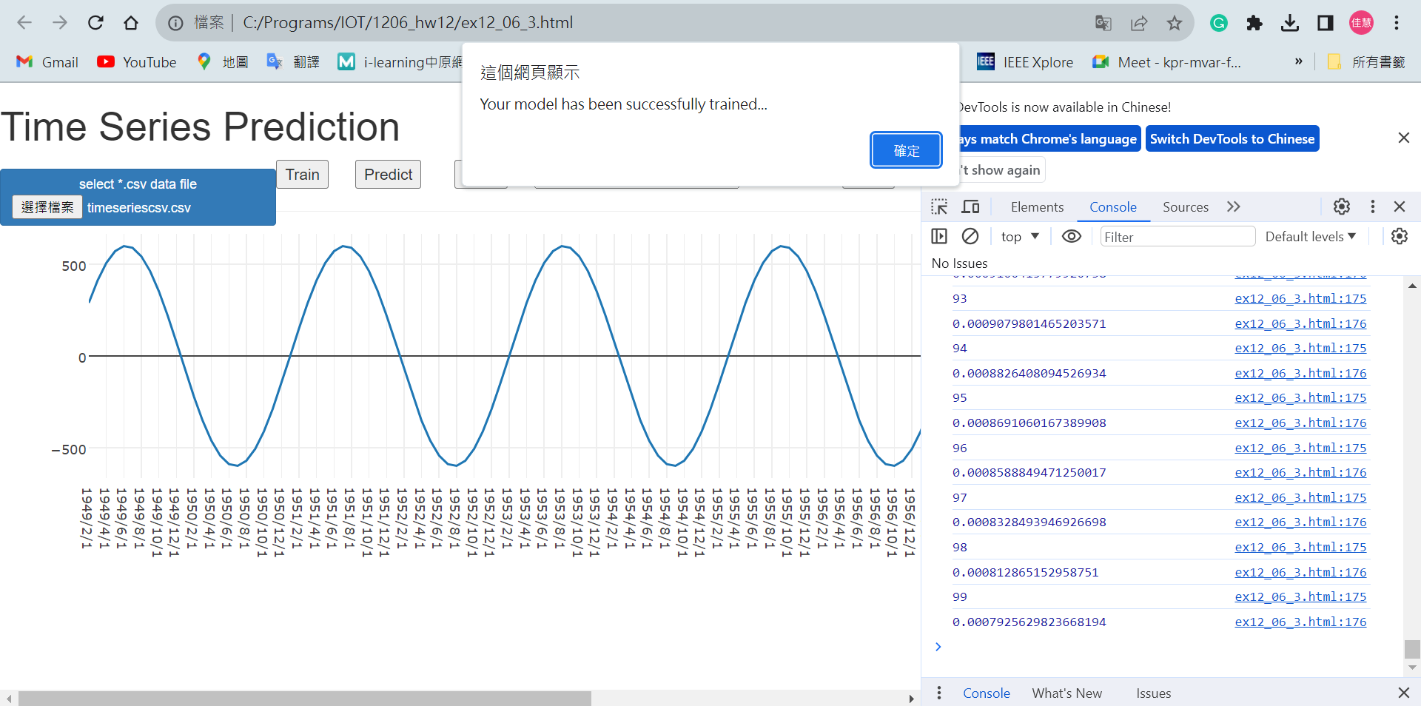
Trainning finished

Slide 30
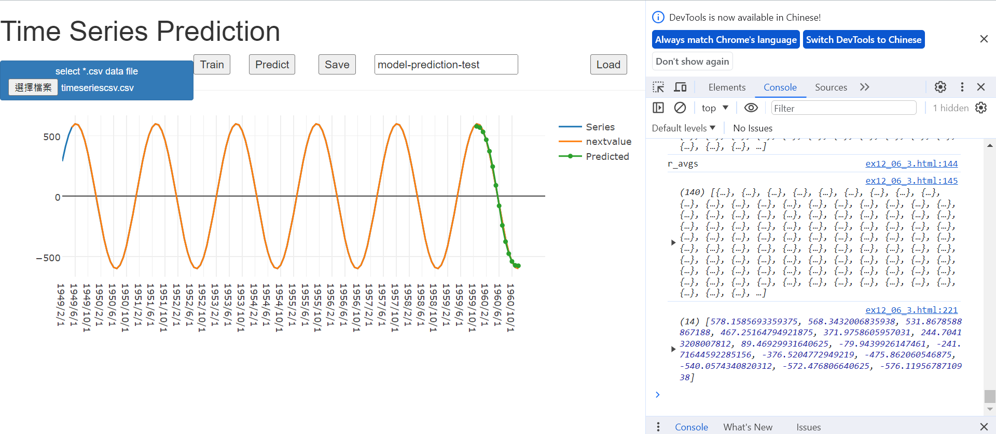
Predict
Predict
Green line: Predicted

Slide 31
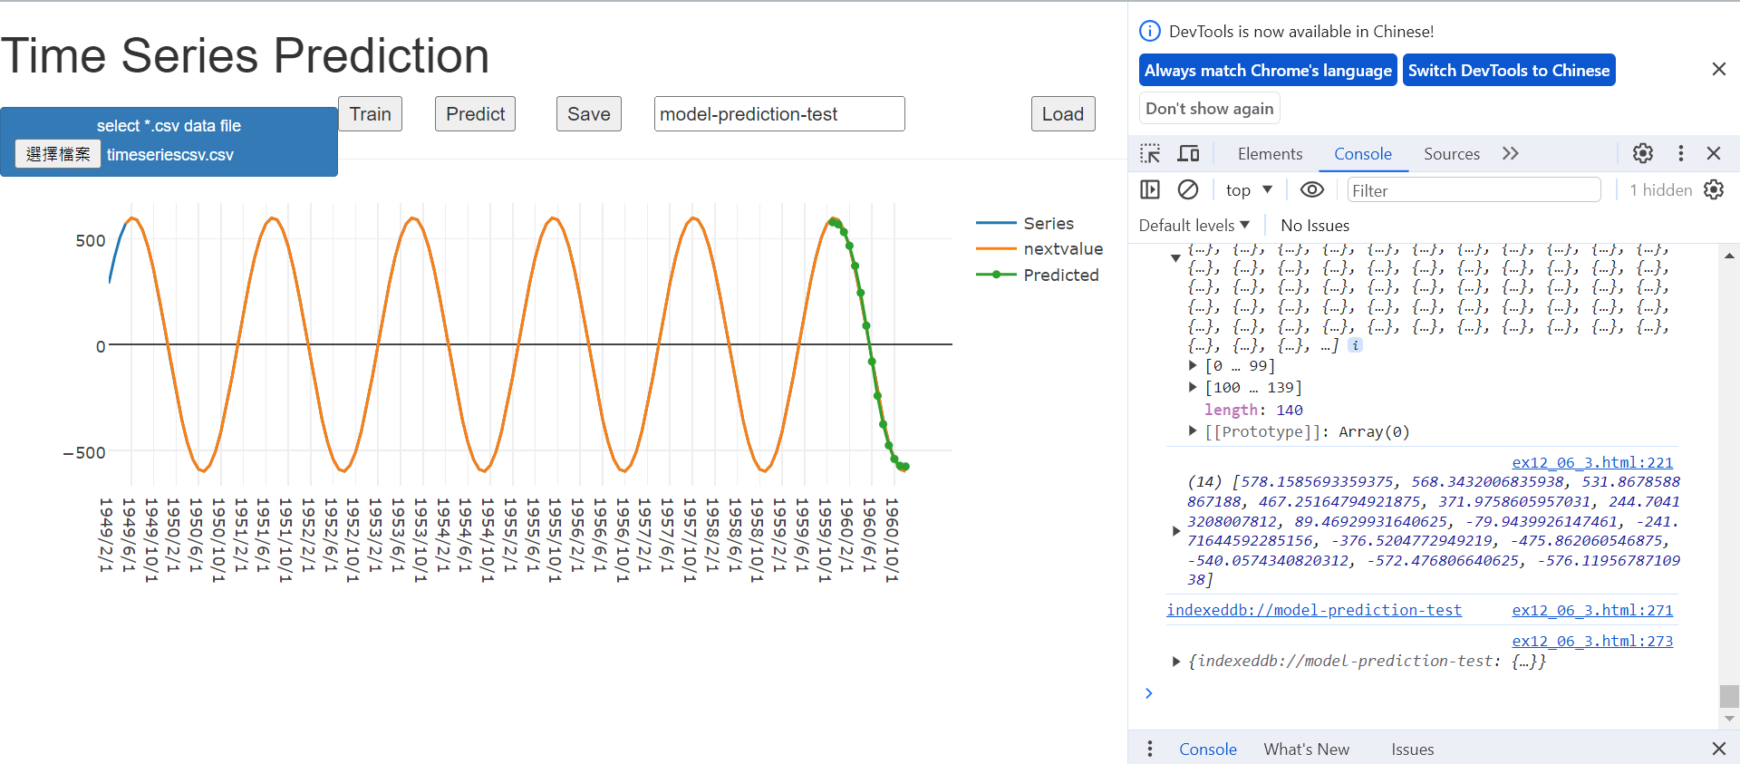
Save
Save
Save address

Slide 32
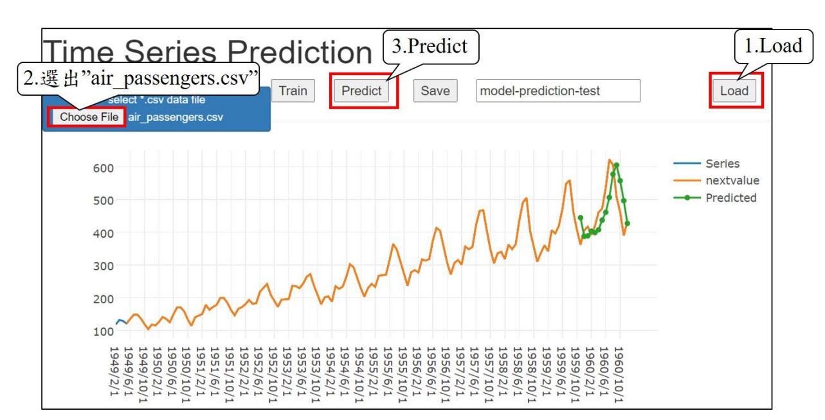
Homework 12-1

Slide 33
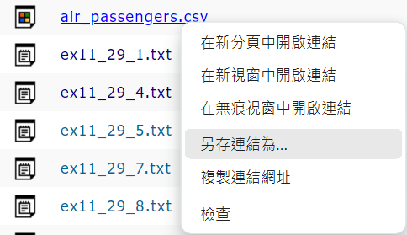
Download air_passengers.csv and save as

Slide 34
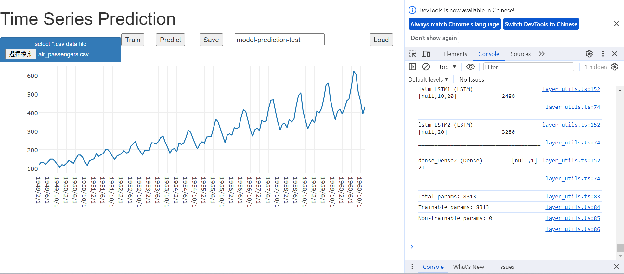
2. Train
3. Predict
1. 選出”air_passengers.csv”

Slide 35
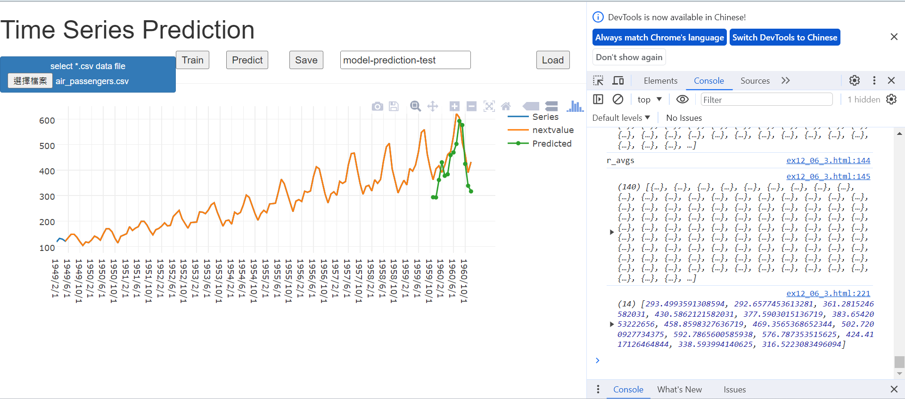
Load
Load
可載入ex12_3訓練好的模型的來查看預測曲線

Slide 36
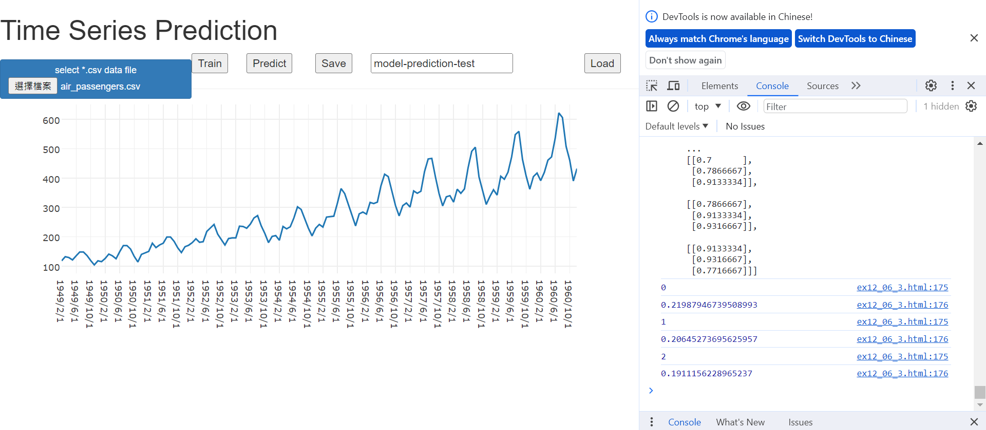
Train
Train
訓練進度

Slide 37
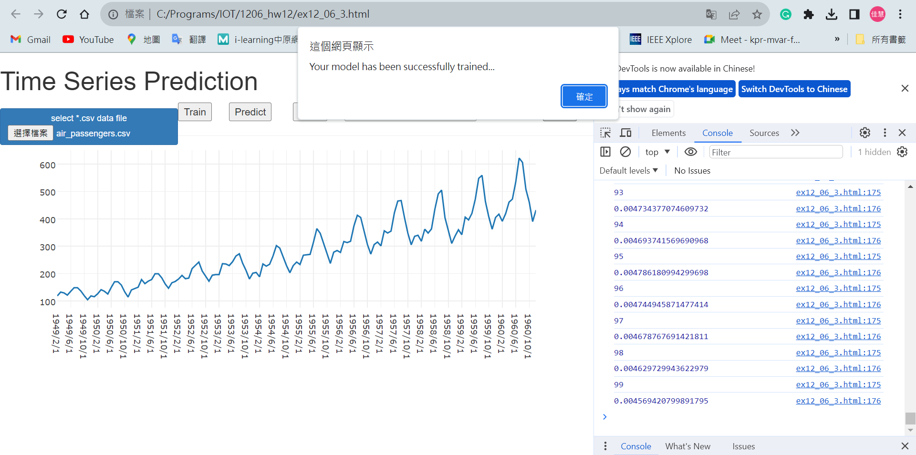
Trainning finished

Slide 38
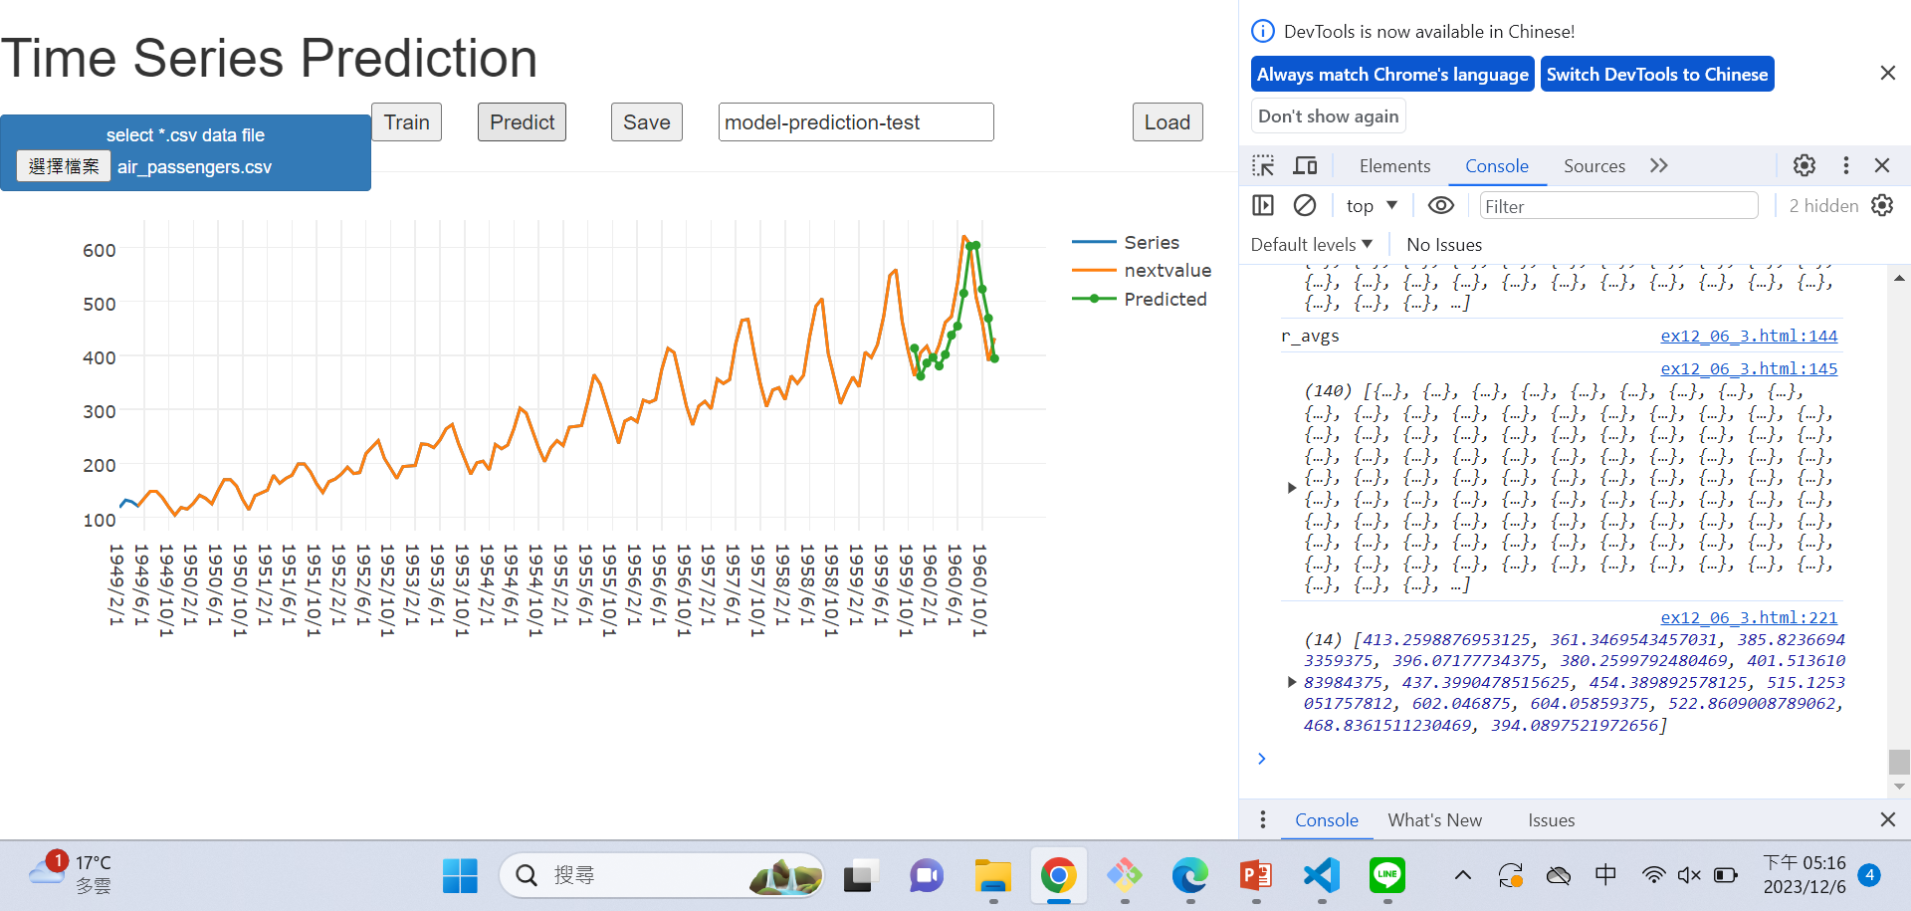
Predict
Predict

